Slide 1
GAD2006 ADVANCED GAME DEVELOPMENT with UE4
GALİP KARTOĞLU

Slide 2
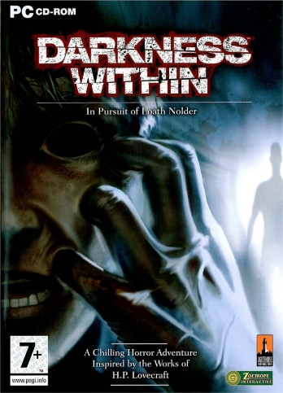


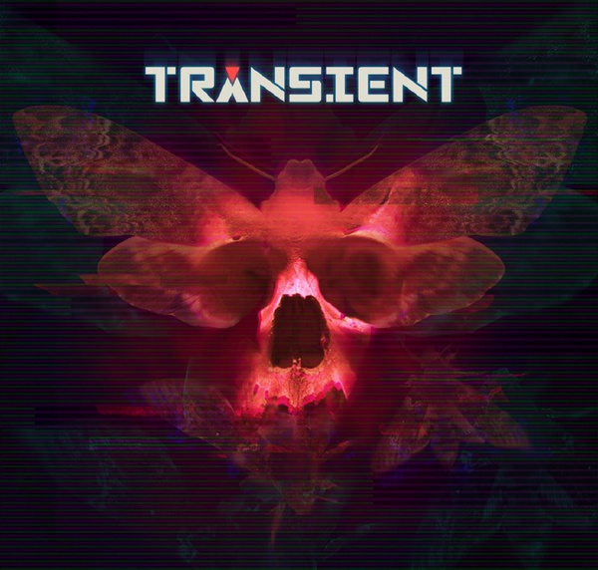
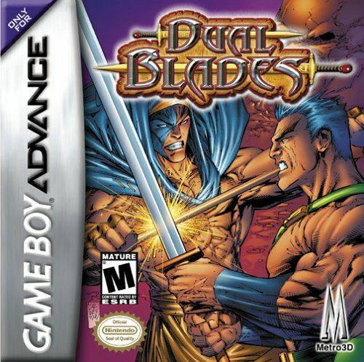
WHO AM I?
Stormling Studios (TEKMER no.801) – Tech Lead / Co-Founder
Dual Blades for Gameboy Advance® (2000) (Programming and Game Design)
Darkness Within (2006) (Engine Programmer)
Darkness Within 2 (2009) (Engine Programmer)
Slashers: Intense 2D Fighting (2013) (Programming and Game Design)
Conarium (Kristal Piksel - Best PC/Game of 2017) (Engine Programmer)
Dual Blades (2019) (Programming and Game Design)
Transient (2020) (Engine Programmer)

Slide 3
ABOUT THIS COURSE
This course contains both theoretical and practical applications on game development.
There will be a final project in which students are required to build a game of their own with the points taught during the classes.
The fundamental aspects of Unreal Engine 4 which were explained in previous Game Development I/II courses will be further explained and get more detailed with every lecture.
Students will be expected to complete assigned projects to demonstrate and develop their skills with blueprints and assisted C++.

Slide 4
COURSE FORMAT
2 Phases: Theory and Labwork
GLTSC02 (5th floor)

Slide 5
USAGE OF DIGITAL TOOLS
Unreal Engine 4.27.2
Keep a copy (or zip-up) of Labwork each week on your computer or drive.
We’ll gradually work on a base project and add more functionality every week.

Slide 6
COMMUNICATION
MS Teams
GAD2006 Advanced Game Development
Announcements
Private messaging
ItsLearning
No Announcements!
Assignments and Project Delivery Only!

Slide 7
OBJECTIVES
1. Have a comprehensive understanding of the game programming concepts such as object-oriented approach, complex data structures, and commonly used algorithms.
2. Get a better understanding at usage of the engine and its components.
3. Get a better competency with the editor.
4. Learn further how the engine works and how it works to help make one's project run efficiently.
5. Learn about the tools and strategies to solve issues and debug errors.

Slide 8
GRADING
Attendance
Missing 4 classes means (on the 5th) automatic failure!
Labworks 30%
2 Assignments (=Midterm) 15%+15%
Final project 40%

Slide 9
Week/Place | Course Topic | Notes | Practices
W1 | Introduction & Scripting Recap |  | Game Sample Mechanics Assessment
W2 | Introduction to Native Programming |  | Labwork #1
W3 | Actor Coding Basics with Assisted C++ |  | Labwork #2
W4 | Content Pipelines & Animation Blueprints |  | Labwork #3
W5 | Breakdown of a Game Prototype | Assignment #1 introduced | Labwork #4
W6 | Developing AI in UE Part #1 |  | Labwork #5
W7 | Developing AI in UE Part #2 | Assignment #2 introduced | Labwork #6
W8 | Introduction to Physics |  | Labwork #7
W9 | Multiplayer Part #1 |  | Labwork #8
W10 | Multiplayer Part #2 | SVN setup | Labwork #9
W11 | UMG |  | Final Project Interview #1
W12 | Optimization and Debugging |  | Final Project Interview #2
W13 | Packaging and Releasing |  | Final Project Interview #3
W14 | Final Project Evaluation

Slide 10
Grade Range | Letter Equivalent
95-100 | A
90-94 | A-
85-89 | B+
80-84 | B
75-79 | B-
70-74 | C+
65-69 | C
60-64 | C-
55-59 | D+
50-54 | D
0-49 | F

Slide 11
FINAL PROJECT
1 Person = 1 Final Project
The project must cover all the points studied in the classes.
Assisted C++
Blueprint communications
Sub-Levels
Animation Blueprints
AI Concepts
Physics
Multiplayer
Graphics and sound assets will not be evaluated!

